Slide 1
BCSE308L -Computer Networks

Slide 2
UNIT I Introduction
Data Communications and Networking: A Communications Model – Data Communications - Evolution of network, Requirements , Applications, Network Topology (Line configuration, Data Flow), Protocols and Standards, Network Models (OSI, TCP/IP)

Slide 3
Introduction
Data communications and networking
  Change the way we do business and the way we live
  Business decisions have to be made more quickly
  Decision depends on immediate access to accurate information
  Business today rely on computer networks and internetworks
  Before get hooked up, we need to know:
    How networks operate
    What types of technologies are available
    Which design best fills which set of needs

Slide 4
Introduction
  Development of the PC changes a lot in business, industry, science and education.
  Similar revolution is occurring in data communication and networking
    Technologies advances are making it possible for communications links to carry more and faster signals
    Services are evolving to allow the use of this expanded capacity
    For example telephone services extended to have:
      Conference calling
      Call waiting
      Voice mail
      Caller ID

Slide 5

1.1 Data Communications
  Communication:
    Means sharing information
      Local (face to face) or remote (over distance)
    Telecommunication
      Telephone, telegraph and television
      Means communication at a distance
      Tele is Greek for far

Slide 6
Data Communications
  Data:
    Refers to information
      Presented in any form
      Agreed upon by the parties ( creating & using)
  Data communication : is the exchange of data between two devices via some form of transmission medium (wire cable).

Slide 7
Data Communications
  Communication system made up of a combination of hardware and software
  Effectiveness of data communication system depends on:
    Delivery : The system must deliver data to correct destination. Data received by the indented user only
    Accuracy: The system must deliver data accurately (no change).
      Data changed & uncorrected is unusable

Slide 8
Data Communications
    Timeliness: The system must deliver data in timely manner
      Data arrived late are useless
      In the same order (video and audio) & without delay (Real time transmission)
    Jitter: Variation in the packet arrival time (uneven quality in the video is the result)

Slide 9
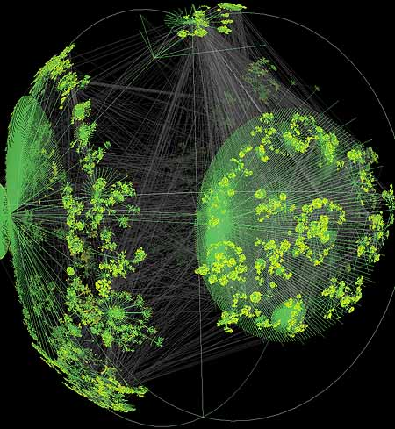
Data Communications

Slide 10

Components
  A data communication system is made up of five components

Slide 11
Components
  Message: the information (data) to be communicated
    Consist of text, numbers, pictures, audio, or video
  Sender: the device that sends the data message
    Computer, workstation, telephone handset, video camera, …
  Receiver: the device that receives the message
    Computer, workstation, telephone handset, television, ….

Slide 12
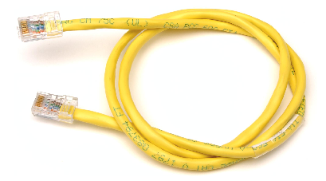


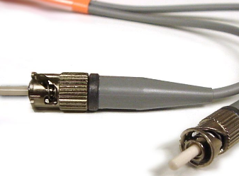
Components
  Medium: The physical path by which a message travels from sender to receiver
    twisted pair, coaxial cable, fiber-optic, radio waves

Slide 13
Components
  Protocol: a set of rules that govern data communications
    An agreement between the communicating devices
    Devices may be connected but not communicating (no protocol)
    Arabic speaker with Japanese speaker

Slide 14
Data Representation
Text
Numbers
Images
Audio
Video

Slide 15
Data Representation
Text:
  Sequence of bits (0s or 1s)
  Different sets of patterns to represent text symbols (each set is called: code)
  ASCII: 7 bits (128 symbols)
  common coding system today is:
  Unicode uses: 32 bits to represent a symbol or character in any language
Unicode
(4,294,967,296)

Slide 16
Data Representation
Numbers:
  Represented by bit patterns
  The number is directly converted to a binary number

Slide 17
Data Representation
Images:
  Represented by bit patterns
  A matrix of
  Resolution: size of the pixels
  High resolution: more memory is needed
  Each pixel is assigned a bit pattern
    1-bit pattern (black and white dots image)
    2-bit pattern (4 levels of gray)
    RGB (color images)
pixels

Slide 18
Data Representation
Audio:
  Continuous not discrete
  Change to digital signal
Video:
  Recording or broadcasting of a picture or movie
  Change to digital signal

Slide 19
Data Flow
Communication between two devices can be:
  Simplex
  Half-Duplex
  Full-Duplex

Slide 20
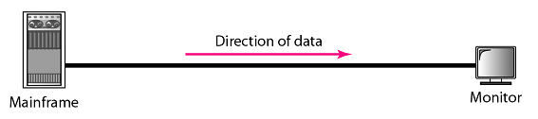
Data Flow
Simplex (one way street)
  The communication is unidirectional
  Only one device on a link can transmit; the other can only receive
  Use the entire capacity of the channel to send data
  Example: Keyboards, Monitors
Data

Slide 21

Data Flow
Half-Duplex (one-lane with two-directional traffic)
  Each station can both transmit and receive, but not at the same time
  When one device is sending, the other can only receive, and vice versa
  The entire capacity of a channel is taken over by the transmitting device
  Example: Walkie-talkies
Data
Data

Slide 22

Data Flow
Full-Duplex (Duplex) (two-way street)
  Both stations can transmit and receive at same time
  Signals going in either direction sharing the capacity of the link
  Sharing can occur in two ways:
    Link has two physically separate transmission paths
      One for sending and the other for receiving
    The capacity of the channel is divided between signals travelling in both directions
  Example: Telephone network
Data
Data

Slide 23

Exercise
What mode of data flow the following exhibits shows?
Answer: Full-Duplex
Data
Data

Slide 24
Networks
  Network : A set of devices (nodes) connected by communication links
    Node : computer, printer, …
    Distributed Processing :
      Most networks used it
      Task is divided among multiple computers instead of one single large computer

Slide 25
Networks
Network Criteria
    Network must meet a certain number of criteria
    The most important of the network criterions are:
      Performance
      Reliability
      Security

Slide 26
Networks
Performance
  Transit time: A mount of time required for a message to travel from one device to another
  Response time: Elapsed time between an inquiry and a response

Slide 27
Networks
Performance
  Performance depends on :
    1- Number of users: large number slow response time.
    2- Type of transmission medium: fiber-optic cabling faster than others cables.
    3- Capabilities of the connected hardware: affect both the speed and capacity of transmission.
    4- Efficiency of the software: process data at the sender and receiver and intermediate affects network performance.

Slide 28
Networks
Performance
  Performance is evaluated by two contradictory networking metrics:
    Throughput (high): a measure of how fast we can actually send data through a network
    Delay (low)

Slide 29
Networks
Reliability
  Reliability is measured by:
    Frequency of failure
    Recovery time of a network after a failure
    Network’s robustness in a catastrophe: protect by good back up network system

Slide 30
Networks
Security
  Protecting data from unauthorized access
  Protecting data from damage and development
  Implementing policies and procedures for recovery from breaches and data losses (Recovery plan)

Slide 31
Networks
Physical Structures:
  Type of connection
    Network: Two or more devices connected through links
    Link: Communication pathway that transfers data from one device two another
    Two devices must be connected in some way to the same link at the same time. Two possible types:
      Point-to-Point
      Multipoint

Slide 32

Networks
Point-to-Point
  Dedicated link between two devices
  Entire capacity of the link is reserved for transmission between those two devices
  Use an actual length of wire or cable

Slide 33
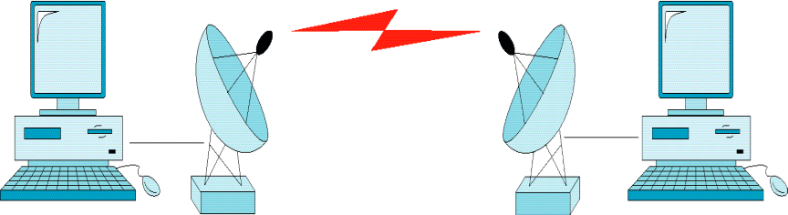
Networks
Point-to-Point
  Other options, such as microwave or satellite is possible
  Example: Television remote control

Slide 34
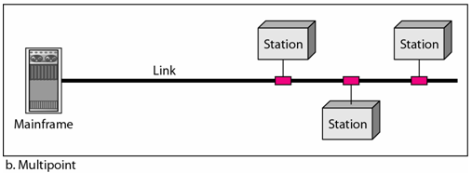
Networks
Multipoint (multidrop)
  More than two devices share a single link
  Capacity is shared
  Channel is shared either spatially or temporally
    Spatially shared: if devices use link at same time
    Timeshare: if users must take turns

Slide 35
Networks
Physical Topology
  The way a network is laid out physically
  Two or more links form a topology
  The topology of a network is the geometric representation of the relationship of all the links and linking devices (nodes) to one another.
  Four topologies : Mesh, Star, Bus, and Ring

Slide 36

Physical Topology

Slide 37

Physical Topology
Mesh
  Every link is dedicated point-to-point link
  The term dedicated means that the link carries traffic only between the two devices it connects

Slide 38
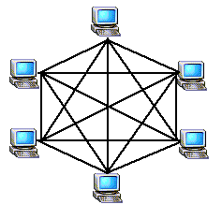
Physical Topology
Mesh
  To link n devices fully connected mesh has:
  n ( n - 1) / 2 physical channels (Full-Duplex)
  Every Device on the network must have
  n - 1 ports

Slide 39

Physical Topology
Mesh
  Example:
  8 devices in mesh has links: n(n-1) / 2
  number of links = 8 (8-1)/2 = 28
  number of ports per device = n – 1 = 8 –1 = 7

Slide 40
Physical Topology
Mesh
  Advantages
    Each connection carry its own data load (no traffic problems)
    A mesh topology is robust
    Privacy or security
    Fault identification and fault isolation

Slide 41
Physical Topology
Mesh:
  Disadvantages
    Big amount of cabling
    Big number of I/O ports
    Installation and reconnection are difficult
    Sheer bulk of the wiring can be greater than the available space
    Hardware connect to each I/O could be expensive
Mesh topology is implemented in a limited fashion; e.g., as backbone of hybrid network

Slide 42

Physical Topology
Star:
  Dedicated point-to-point to a central controller (Hub)
  No direct traffic between devices
  The control acts as an exchange

Slide 43

Physical Topology
Star
  Advantages
    Less expensive than mesh
    (1 Link + 1 port per device)
    Easy to install and reconfigure
    Less cabling
    Additions, moves, and deletions required one connection
    Robustness : one fail does not affect others
    Easy fault identification and fault isolation

Slide 44
Physical Topology
Star
  Disadvantages
    Dependency of the whole topology on one single point (hub)
    More cabling than other topologies ( ring or bus)
Used in LAN

Slide 45
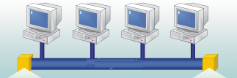
Physical Topology
Bus
  It is multipoint
  One long cable acts as a backbone
  Used in the design of early LANS, and Ethernet LANs

Slide 46

Physical Topology
Bus
  Nodes connect to cable by drop lines and taps
  Signal travels along the backbone and some of its energy is transformed to heat
  Limit of number of taps and the distance between taps

Slide 47

Physical Topology
Bus
  Advantages
    Ease of installation
    Less cables than mesh, star topologies
  Disadvantages
    Difficult reconnection and fault isolation ( limit of taps)
    Adding new device requires modification of backbone
    Fault or break stops all transmission
    The damaged area reflects signals back in the direction of the origin, creating noise in both directions

Slide 48

Physical Topology
Ring
  Each device has dedicated point-to-point connection with only the two devices on either side of it
  A signal is passed along the ring in one direction from device to device until it reaches its destination
  Each devices incorporates a Repeater

Slide 49

Physical Topology
Ring
  Advantages
    Easy of install and reconfigure
    Connect to immediate neighbors
    Move two connections for any moving (Add/Delete)
    Easy of fault isolation
  Disadvantage
    Unidirectional
    One broken device can disable the entire network. This weakness can be solved by using a dual ring or a switch capable of closing off the break

Slide 50

Physical Topology
Hybrid Topology
  Example: having a main star topology with each branch connecting several stations in a bus topology

Slide 51
Categories of Networks
Network Category depends on its size
Two primary categories
  LAN: Covers area < 2miles
  WAN: Can be worldwide
  MAN: Between LAN & WAN, span 10s of miles

Slide 52
Local Area Network (LAN)
Privately owned
Links devices in the same office, building, or campus
Simple LAN: 2 PCs & 1 printer in home or office
Size is limited to a few kilometers
Allow resources to be shared (hardware, software, or data)

Slide 53

Local Area Network (LAN)
An isolated LAN connecting 12 computers to a hub in a closet

Slide 54
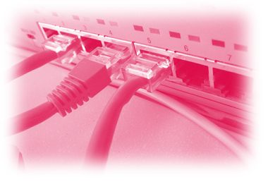
Local Area Network (LAN)
LAN is distinguished by:
  Size (# users of OS, or licensing restrictions)
  Transmission medium (only one type)
  Topology (bus, ring, star)
Data Rates (speed):
  Early: 4 to 16 Mbps
  Today: 100 to 1000 Mbps

Slide 55
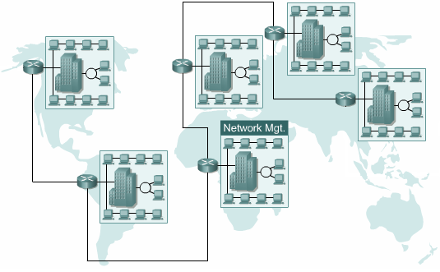
Wide Area Networks (WAN)
Provides long-distance transmission of data over large geographic areas (country, continent, world)

Slide 56
Wide Area Networks (WAN)
Switched WAN
  Backbone of the Internet
Dialup line point-to-point WAN
  Leased line from a telephone company

Slide 57

Wide Area Networks (WAN)

Slide 58
Metropolitan Area Networks (MAN)
Size between LAN and WAN
Inside a town or a city
Example: the part of the telephone company network that can provide a high-speed DSL to the customer

Slide 59

Interconnection of Networks: Internetworks
Two or more networks connected together

Slide 60
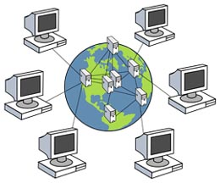
The Internet
Internet has revolutionized many aspects of our daily lives.
It has affected the way we do business as well as the way we spend our leisure time.
Internet is a communication system that has brought a wealth of information to our fingertips and organized it for our use
An internet is 2 or more networks that can communicate with each other
The Internet is a collaboration of more than hundreds of thousands of interconnected networks

Slide 61
The Internet
An internet (small i) is two or more networks
Notable internet is called the Internet (hundreds of thousands interconnected networks)
  Private individuals + government agencies + school + research facilities +
  Corporations + libraries in more than 100 countries
This communication system came in 1969
Mid-1960 (ARPA) Advanced Research Projects Agency in (DOD) was interested to connect mainframes in research organizations
1967, ARPA presented its ideas for ARPANET
  Host computer connecting to (IMP) interface message processor.
  Each IMP communicate with other IMP
1969, four nodes (universities) connected via IMPs to form a network
  Software (NCP) Network Control Protocol provided communication between the hosts.
1972, Vint Cerf and Bob Kahn invented (TCP) Transmission Control Protocol
Later TCP was split to (TCP) Transmission Control Protocol and (IP) Internetworking Protocol

Slide 62
The Internet
Internet Today
  Made of many LANs and WANs
  Every day new networks area added and removed
  Internet services Providers (ISPs) offer services to the end users
    International service providers
    National service providers
    Regional service providers
    Local service providers
Data
rate

Slide 63

The Internet
Hierarchical organization of the Internet

Slide 64
Protocols and Standards
Protocol synonymous with rule
Standards: agreed-upon rules
Protocols
  A protocol is a set of rules that govern data communications
  Defines What, How, and When it is communicated

Slide 65
Protocols and Standards
Elements of a protocol:
  Syntax: structure or format of data
    Example: 8-bits address of sender, 8-bits address of receiver
  Semantics: meaning of each section of bits
    Example: Does the address is a route to be taken or the final destination of the message
  Timing: when data should be sent and how fast they can be sent
    Example: sender produces data at 100 Mbps but the receiver can process data at only 1 Mbps ⇒ overload and data loose

Slide 66
Standards
Essential in creating and maintaining an open and competitive market for equipment manufactures
Guaranteeing national and international interoperability of data and telecommunication technology and processes
Providing guidelines to manufacturers, vendors, government agencies, and other service providers to ensure the kind of interconnectivity necessary in today’s marketplace and in international communications

Slide 67
Standards
Two categories
  De facto: not approved by an organized body but adopted as standards through widespread use
  De jure: Legislated by an officially recognized body

Slide 68
Standards
Standards are developed through the cooperation of:
  Standards Creation Committees
    ISO, ITU-T, CCITT, ANSI, IEEE, EIA
  Forums
    Created by special-interest groups
    Present their conclusions to the standards bodies
  Regulatory Agencies
    Ministry of Telecommunication and Information Technology (KSA)
    Purpose: Protecting the public by regulating radio, television, and communication

Slide 69
Standards
Internet standards
  Tested thoroughly tested specification that is useful to be adhered to by those who work with the Internet
  Formalized regulation that must be followed
  Specification become Internet standard
    Begins as Internet draft for 6 months
    Upon recommendation from the Internet authorities draft published as Request for Comment (RFC)
    RFC is edited, assigned a number, and made available to all interested parties

